Slide 1
Presentation Outline
Basic Elements of Assembly Language
Flat Memory Program Template
Example: Adding and Subtracting Integers
Assembling, Linking, and Debugging Programs
Defining Data
Defining Symbolic Constants
Data-Related Operators and Directives

Slide 2
Constants
Integer Constants
  Examples: –10, 42d, 10001101b, 0FF3Ah, 777o
  Radix: b = binary, d = decimal, h = hexadecimal, and o = octal
  If no radix is given, the integer constant is decimal
  A hexadecimal beginning with a letter must have a leading 0
Character and String Constants
  Enclose character or string in single or double quotes
  Examples: 'A', "d", 'ABC', "ABC", '4096'
  Embedded quotes: "single quote ' inside", 'double quote " inside'
  Each ASCII character occupies a single byte

Slide 3
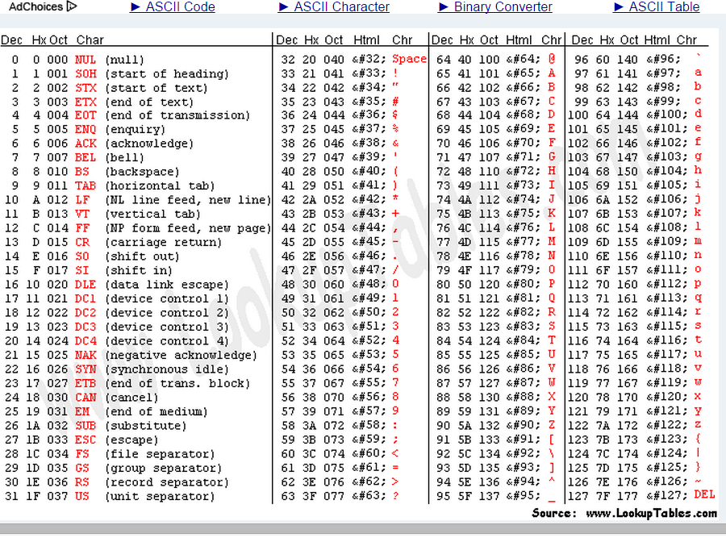

Slide 4
Basic Program Execution Registers
Registers are high speed memory inside the CPU
  Eight 32-bit general-purpose registers
  Six 16-bit segment registers
  Processor Status Flags (EFLAGS) and Instruction Pointer (EIP)
32-bit General-Purpose Registers
EAX
EBP
EBX
ESP
ECX
ESI
EDX
EDI
16-bit Segment Registers
EFLAGS
CS
ES
SS
FS
EIP
DS
GS

Slide 5
General-Purpose Registers
Used primarily for arithmetic and data movement
  mov eax, 10 move constant 10 into register eax
Specialized uses of Registers
  EAX – Accumulator register
    Automatically used by multiplication and division instructions
  ECX – Counter register
    Automatically used by LOOP instructions
  ESP – Stack Pointer register
    Used by PUSH and POP instructions, points to top of stack
  ESI and EDI – Source Index and Destination Index register
    Used by string instructions
  EBP – Base Pointer register
    Used to reference parameters and local variables on the stack

Slide 6



Accessing Parts of Registers
EAX, EBX, ECX, and EDX are 32-bit Extended registers
  Programmers can access their 16-bit and 8-bit parts
  Lower 16-bit of EAX is named AX
  AX is further divided into
    AL = lower 8 bits
    AH = upper 8 bits
ESI, EDI, EBP, ESP have only
16-bit names for lower half

Slide 7
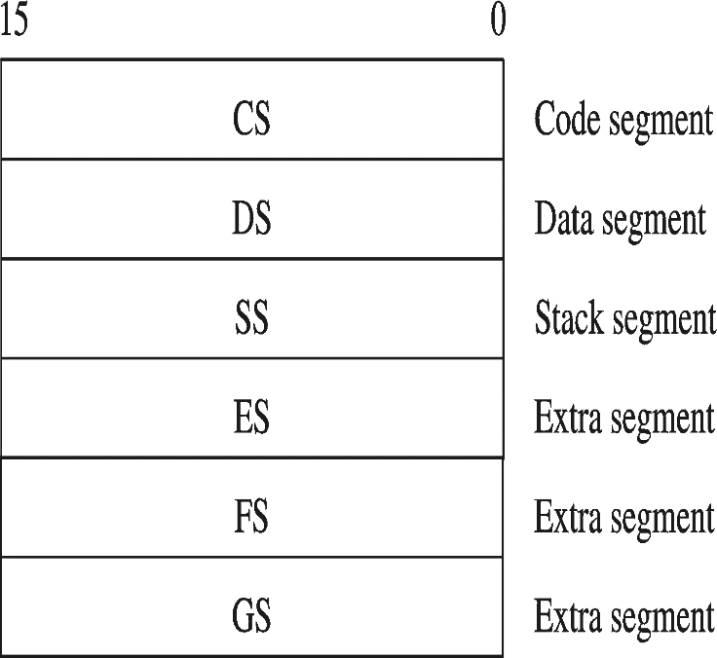
Special-Purpose & Segment Registers
EIP = Extended Instruction Pointer
  Contains address of next instruction to be executed
EFLAGS = Extended Flags Register
  Contains status and control flags
  Each flag is a single binary bit
Six 16-bit Segment Registers
  Support segmented memory
  Six segments accessible at a time
  Segments contain distinct contents
    Code
    Data
    Stack

Slide 8
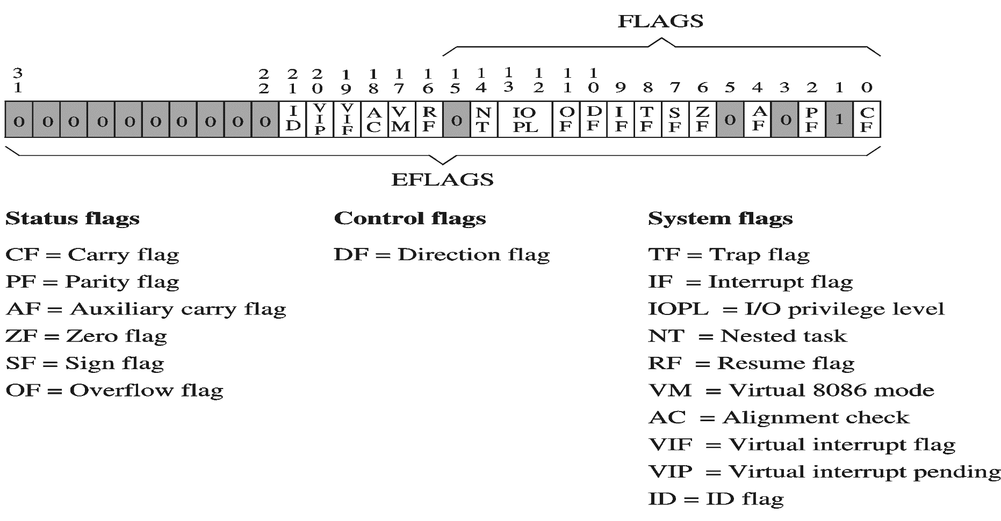
EFLAGS Register
Status Flags
  Status of arithmetic and logical operations
Control and System flags
  Control the CPU operation
Programs can set and clear individual bits in the EFLAGS register

Slide 9
Status Flags
Carry Flag
  Set when unsigned arithmetic result is out of range
Overflow Flag
  Set when signed arithmetic result is out of range
Sign Flag
  Copy of sign bit, set when result is negative
Zero Flag
  Set when result is zero
Auxiliary Carry Flag
  Set when there is a carry from bit 3 to bit 4
Parity Flag
  Set when parity is even
  Least-significant byte in result contains even number of 1s

Slide 10

Floating-Point, MMX, XMM Registers
Floating-point unit performs high speed FP operations
Eight 80-bit floating-point data registers
  ST(0), ST(1), . . . , ST(7)
  Arranged as a stack
  Used for floating-point arithmetic
Eight 64-bit MMX registers
  Used with MMX instructions
Eight 128-bit XMM registers
  Used with SSE instructions

Slide 11
Assembly Language Statements
Three types of statements in assembly language
  Typically, one statement should appear on a line
Executable Instructions
  Generate machine code for the processor to execute at runtime
  Instructions tell the processor what to do
Assembler Directives
  Provide information to the assembler while translating a program
  Used to define data, select memory model, etc.
  Non-executable: directives are not part of instruction set
Macros
  Shorthand notation for a group of statements
  Sequence of instructions, directives, or other macros

Slide 12
Instructions
Assembly language instructions have the format:
[label:] mnemonic [operands] [;comment]
Instruction Label (optional)
  Marks the address of an instruction, must have a colon :
  Used to transfer program execution to a labeled instruction
Mnemonic
  Identifies the operation (e.g. MOV, ADD, SUB, JMP, CALL)
Operands
  Specify the data required by the operation
  Executable instructions can have zero to three operands
  Operands can be registers, memory variables, or constants

Slide 13
Instruction Examples
No operands
  stc ; set carry flag
One operand
  inc eax ; increment register eax
  call Clrscr ; call procedure Clrscr
  jmp L1 ; jump to instruction with label L1
Two operands
  add ebx, ecx ; register ebx = ebx + ecx
  sub var1, 25 ; memory variable var1 = var1 - 25
Three operands
  imul eax,ebx,5 ; register eax = ebx * 5

Slide 14
Identifiers
Identifier is a programmer chosen name
Identifies variable, constant, procedure, code label
May contain between 1 and 247 characters
Not case sensitive
First character must be a letter (A..Z, a..z), underscore(_), @, ?, or $.
Subsequent characters may also be digits.
Cannot be same as assembler reserved word.

Slide 15
Comments
Comments are very important!
  Explain the program's purpose
  When it was written, revised, and by whom
  Explain data used in the program
  Explain instruction sequences and algorithms used
  Application-specific explanations
Single-line comments
  Begin with a semicolon ; and terminate at end of line
Multi-line comments
  Begin with COMMENT directive and a chosen character
  End with the same chosen character

Slide 16
Next . . .
Basic Elements of Assembly Language
Flat Memory Program Template
Example: Adding and Subtracting Integers
Assembling, Linking, and Debugging Programs
Defining Data
Defining Symbolic Constants
Data-Related Operators and Directives

Slide 17
Flat Memory Program Template
TITLE Flat Memory Program Template (Template.asm)
; Program Description:
; Author: Creation Date:
; Modified by: Modification Date:
.686
.MODEL FLAT, STDCALL
.STACK
INCLUDE Irvine32.inc
.DATA
; (insert variables here)
.CODE
main PROC
; (insert executable instructions here)
exit
main ENDP
; (insert additional procedures here)
END main

Slide 18
TITLE and .MODEL Directives
TITLE line (optional)
  Contains a brief heading of the program and the disk file name
.MODEL directive
  Specifies the memory configuration
  For our purposes, the FLAT memory model will be used
    Linear 32-bit address space (no segmentation)
  STDCALL directive tells the assembler to use …
    Standard conventions for names and procedure calls
.686 processor directive
  Used before the .MODEL directive
  Program can use instructions of Pentium P6 architecture
  At least the .386 directive should be used with the FLAT model

Slide 19
.STACK, .DATA, & .CODE Directives
.STACK directive
  Tells the assembler to define a runtime stack for the program
  The size of the stack can be optionally specified by this directive
  The runtime stack is required for procedure calls
.DATA directive
  Defines an area in memory for the program data
  The program's variables should be defined under this directive
  Assembler will allocate and initialize the storage of variables
.CODE directive
  Defines the code section of a program containing instructions
  Assembler will place the instructions in the code area in memory

Slide 20
INCLUDE, PROC, ENDP, and END
INCLUDE directive
  Causes the assembler to include code from another file
  We will include Irvine32.inc provided by the author Kip Irvine
    Declares procedures implemented in the Irvine32.lib library
    To use this library, you should link Irvine32.lib to your programs
PROC and ENDP directives
  Used to define procedures
  As a convention, we will define main as the first procedure
  Additional procedures can be defined after main
END directive
  Marks the end of a program
  Identifies the name (main) of the program’s startup procedure

Slide 21
Next . . .
Basic Elements of Assembly Language
Flat Memory Program Template
Example: Adding and Subtracting Integers
Assembling, Linking, and Debugging Programs
Defining Data
Defining Symbolic Constants
Data-Related Operators and Directives

Slide 22
Adding and Subtracting Integers
TITLE Add and Subtract (AddSub.asm)
; This program adds and subtracts 32-bit integers.
.686
.MODEL FLAT, STDCALL
.STACK
INCLUDE Irvine32.inc
.CODE
main PROC
mov eax,10000h ; EAX = 10000h
add eax,40000h ; EAX = 50000h
sub eax,20000h ; EAX = 30000h
call DumpRegs ; display registers
exit
main ENDP
END main

Slide 23
Example of Console Output
Procedure DumpRegs is defined in Irvine32.lib library
It produces the following console output,
showing registers and flags:
EAX=00030000 EBX=7FFDF000 ECX=00000101 EDX=FFFFFFFF
ESI=00000000 EDI=00000000 EBP=0012FFF0 ESP=0012FFC4
EIP=00401024 EFL=00000206 CF=0 SF=0 ZF=0 OF=0

Slide 24
Suggested Coding Standards
Some approaches to capitalization
  Capitalize nothing
  Capitalize everything
  Capitalize all reserved words, mnemonics and register names
  Capitalize only directives and operators
  MASM is NOT case sensitive: does not matter what case is used
Other suggestions
  Use meaningful identifier names
  Use blank lines between procedures
  Use indentation and spacing to align instructions and comments
    Use tabs to indent instructions, but do not indent labels
    Align the comments that appear after the instructions

Slide 25
Understanding Program Termination
The exit at the end of main procedure is a macro
  Defined in Irvine32.inc
  Expanded into a call to ExitProcess that terminates the program
  ExitProcess function is defined in the kernel32 library
  We can replace exit with the following:
  push 0 ; push parameter 0 on stack
  call ExitProcess ; to terminate program
  You can also replace exit with: INVOKE ExitProcess, 0
PROTO directive (Prototypes)
  Declares a procedure used by a program and defined elsewhere
  ExitProcess PROTO, ExitCode:DWORD
  Specifies the parameters and types of a given procedure

Slide 26
Modified Program
TITLE Add and Subtract (AddSubAlt.asm)
; This program adds and subtracts 32-bit integers
.686
.MODEL flat,stdcall
.STACK 4096
; No need to include Irvine32.inc
ExitProcess PROTO, dwExitCode:DWORD
.code
main PROC
mov eax,10000h ; EAX = 10000h
add eax,40000h ; EAX = 50000h
sub eax,20000h ; EAX = 30000h
push 0
call ExitProcess ; to terminate program
main ENDP
END main

Slide 27
Next . . .
Basic Elements of Assembly Language
Flat Memory Program Template
Example: Adding and Subtracting Integers
Assembling, Linking, and Debugging Programs
Defining Data
Defining Symbolic Constants
Data-Related Operators and Directives

Slide 28
Assemble-Link-Debug Cycle
Editor
  Write new (.asm) programs
  Make changes to existing ones
Assembler: ML.exe program
  Translate (.asm) file into object (.obj) file in machine language
  Can produce a listing (.lst) file that shows the work of assembler
Linker: LINK32.exe program
  Combine object (.obj) files with link library (.lib) files
  Produce executable (.exe) file
  Can produce optional (.map) file
Edit
prog.asm
Assemble
library.lib
prog.obj
prog.lst
Link
prog.exe
prog.map
Debug
Run

Slide 29
Assemble-Link-Debug Cycle – cont'd
MAKE32.bat
  Batch command file
  Assemble and link in one step
Debugger: WINDBG.exe
  Trace program execution
    Either step-by-step, or
    Use breakpoints
  View
    Source (.asm) code
    Registers
    Memory by name & by address
    Modify register & memory content
  Discover errors and go back to the editor to fix the program bugs
Edit
prog.asm
Assemble
library.lib
prog.obj
prog.lst
Link
prog.exe
prog.map
Debug
Run

Slide 30
Listing File
Use it to see how your program is assembled
Contains
  Source code
  Object code
  Relative addresses
  Segment names
  Symbols
    Variables
    Procedures
    Constants
Object & source code in a listing file
00000000 .code
00000000 main PROC
00000000 B8 00060000 mov eax, 60000h
00000005 05 00080000 add eax, 80000h
0000000A 2D 00020000 sub eax, 20000h
0000000F 6A 00 push 0
00000011 E8 00000000 E call ExitProcess
00000016 main ENDP
END main
Relative
Addresses
object code
(hexadecimal)
source code

Slide 31
Next . . .
Basic Elements of Assembly Language
Flat Memory Program Template
Example: Adding and Subtracting Integers
Assembling, Linking, and Debugging Programs
Defining Data
Defining Symbolic Constants
Data-Related Operators and Directives

Slide 32
Intrinsic Data Types
BYTE, SBYTE
  8-bit unsigned integer
  8-bit signed integer
WORD, SWORD
  16-bit unsigned integer
  16-bit signed integer
DWORD, SDWORD
  32-bit unsigned integer
  32-bit signed integer
QWORD, TBYTE
  64-bit integer
  80-bit integer
REAL4
  IEEE single-precision float
  Occupies 4 bytes
REAL8
  IEEE double-precision
  Occupies 8 bytes
REAL10
  IEEE extended-precision
  Occupies 10 bytes

Slide 33
Data Definition Statement
Sets aside storage in memory for a variable
May optionally assign a name (label) to the data
Syntax:
[name] directive initializer [, initializer] . . .
  val1 BYTE 10
All initializers become binary data in memory

Slide 34
Defining BYTE and SBYTE Data
Each of the following defines a single byte of storage:
value1 BYTE 'A' ; character constant
value2 BYTE 0 ; smallest unsigned byte
value3 BYTE 255 ; largest unsigned byte
value4 SBYTE -128 ; smallest signed byte
value5 SBYTE +127 ; largest signed byte
value6 BYTE ? ; uninitialized byte
MASM does not prevent you from initializing a BYTE with a negative value, but it's considered poor style.
If you declare a SBYTE variable, the Microsoft debugger will automatically display its value in decimal with a leading sign.

Slide 35
Defining Byte Arrays
Examples that use multiple initializers
list1 BYTE 10,20,30,40
list2 BYTE 10,20,30,40
BYTE 50,60,70,80
BYTE 81,82,83,84
list3 BYTE ?,32,41h,00100010b
list4 BYTE 0Ah,20h,'A',22h

Slide 36
Defining Strings
A string is implemented as an array of characters
  For convenience, it is usually enclosed in quotation marks
  It is often terminated with a NULL char (byte value = 0)
Examples:
str1 BYTE "Enter your name", 0
str2 BYTE 'Error: halting program', 0
str3 BYTE 'A','E','I','O','U'
greeting BYTE "Welcome to the Encryption "
BYTE "Demo Program", 0

Slide 37
Defining Strings – cont'd
To continue a single string across multiple lines, end each line with a comma
menu BYTE "Checking Account",0dh,0ah,0dh,0ah,
"1. Create a new account",0dh,0ah,
"2. Open an existing account",0dh,0ah,
"3. Credit the account",0dh,0ah,
"4. Debit the account",0dh,0ah,
"5. Exit",0ah,0ah,
"Choice> ",0
End-of-line character sequence:
  0Dh = 13 = carriage return
  0Ah = 10 = line feed
Idea: Define all strings used by your program in the same area of the data segment

Slide 38
Using the DUP Operator
Use DUP to allocate space for an array or string
  Advantage: more compact than using a list of initializers
Syntax
  counter DUP ( argument )
  Counter and argument must be constants expressions
The DUP operator may also be nested
var1 BYTE 20 DUP(0) ; 20 bytes, all equal to zero
var2 BYTE 20 DUP(?) ; 20 bytes, all uninitialized
var3 BYTE 4 DUP("STACK") ; 20 bytes: "STACKSTACKSTACKSTACK"
var4 BYTE 10,3 DUP(0),20 ; 5 bytes: 10, 0, 0, 0, 20
var5 BYTE 2 DUP(5 DUP('*'), 5 DUP('!')) ; '*****!!!!!*****!!!!!'

Slide 39
Defining 16-bit and 32-bit Data
Define storage for 16-bit and 32-bit integers
  Signed and Unsigned
  Single or multiple initial values
word1 WORD 65535 ; largest unsigned 16-bit value
word2 SWORD –32768 ; smallest signed 16-bit value
word3 WORD "AB" ; two characters fit in a WORD
array1 WORD 1,2,3,4,5 ; array of 5 unsigned words
array2 SWORD 5 DUP(?) ; array of 5 signed words
dword1 DWORD 0ffffffffh ; largest unsigned 32-bit value
dword2 SDWORD –2147483648 ; smallest signed 32-bit value
array3 DWORD 20 DUP(?) ; 20 unsigned double words
array4 SDWORD –3,–2,–1,0,1 ; 5 signed double words

Slide 40
QWORD, TBYTE, and REAL Data
QWORD and TBYTE
  Define storage for 64-bit and 80-bit integers
  Signed and Unsigned
REAL4, REAL8, and REAL10
  Defining storage for 32-bit, 64-bit, and 80-bit floating-point data
quad1 QWORD 1234567812345678h
val1 TBYTE 1000000000123456789Ah
rVal1 REAL4 -2.1
rVal2 REAL8 3.2E-260
rVal3 REAL10 4.6E+4096
array REAL4 20 DUP(0.0)

Slide 41
Symbol Table
Assembler builds a symbol table
  So we can refer to the allocated storage space by name
  Assembler keeps track of each name and its offset
  Offset of a variable is relative to the address of the first variable
Example Symbol Table
.DATA Name Offset
value WORD 0 value 0
sum DWORD 0 sum 2
marks WORD 10 DUP (?) marks 6
msg BYTE 'The grade is:',0 msg 26
char1 BYTE ? char1 40

Slide 42
Byte Ordering and Endianness
Processors can order bytes within a word in two ways
Little Endian Byte Ordering
  Memory address = Address of least significant byte
  Examples: Intel 80x86
Big Endian Byte Ordering
  Memory address = Address of most significant byte
  Examples: MIPS, Motorola 68k, SPARC
MSB
LSB
address
a
a+1
a+2
a+3
Byte 3
Byte 2
Byte 1
Byte 0
. . .
Byte 0
Byte 1
Byte 2
Byte 3
. . .
32-bit Register
Memory
MSB
LSB
address
a
a+1
a+2
a+3
Byte 0
Byte 1
Byte 2
Byte 3
. . .
Byte 3
Byte 2
Byte 1
Byte 0
. . .
32-bit Register
Memory

Slide 43
Adding Variables to AddSub
TITLE Add and Subtract, Version 2 (AddSub2.asm)
.686
.MODEL FLAT, STDCALL
.STACK
INCLUDE Irvine32.inc
.DATA
val1 DWORD 10000h
val2 DWORD 40000h
val3 DWORD 20000h
result DWORD ?
.CODE
main PROC
mov eax,val1 ; start with 10000h
  add eax,val2 ; add 40000h
  sub eax,val3 ; subtract 20000h
  mov result,eax ; store the result (30000h)
  call DumpRegs ; display the registers
  exit
main ENDP
END main

Slide 44
Next . . .
Basic Elements of Assembly Language
Flat Memory Program Template
Example: Adding and Subtracting Integers
Assembling, Linking, and Debugging Programs
Defining Data
Defining Symbolic Constants
Data-Related Operators and Directives

Slide 45
Defining Symbolic Constants
Symbolic Constant
  Just a name used in the assembly language program
  Processed by the assembler ⇒ pure text substitution
  Assembler does NOT allocate memory for symbolic constants
Assembler provides three directives:
  = directive
  EQU directive
  TEXTEQU directive
Defining constants has two advantages:
  Improves program readability
  Helps in software maintenance: changes are done in one place

Slide 46
Equal-Sign Directive
Name = Expression
  Name is called a symbolic constant
  Expression is an integer constant expression
Good programming style to use symbols
Name can be redefined in the program
COUNT = 500 ; NOT a variable (NO memory allocation)
. . .
mov eax, COUNT ; mov eax, 500
. . .
COUNT = 600 ; Processed by the assembler
. . .
mov ebx, COUNT ; mov ebx, 600

Slide 47
EQU Directive
Three Formats:
Name EQU Expression Integer constant expression
Name EQU Symbol Existing symbol name
Name EQU <text> Any text may appear within < …>
No Redefinition: Name cannot be redefined with EQU
SIZE EQU 10*10 ; Integer constant expression
PI EQU <3.1416> ; Real symbolic constant
PressKey EQU <"Press any key to continue...",0>
.DATA
prompt BYTE PressKey

Slide 48
TEXTEQU Directive
TEXTEQU creates a text macro. Three Formats:
Name TEXTEQU <text> assign any text to name
Name TEXTEQU textmacro assign existing text macro
Name TEXTEQU %constExpr constant integer expression
Name can be redefined at any time (unlike EQU)
ROWSIZE = 5
COUNT TEXTEQU %(ROWSIZE * 2) ; evaluates to 10
MOVAL TEXTEQU <mov al,COUNT>
ContMsg TEXTEQU <"Do you wish to continue (Y/N)?">
.DATA
prompt BYTE ContMsg
.CODE
MOVAL ; generates: mov al,10

Slide 49
Next . . .
Basic Elements of Assembly Language
Flat Memory Program Template
Example: Adding and Subtracting Integers
Assembling, Linking, and Debugging Programs
Defining Data
Defining Symbolic Constants
Data-Related Operators and Directives

Slide 50
OFFSET Operator
OFFSET = address of a variable within its segment
  In FLAT memory, one address space is used for code and data
  OFFSET = linear address of a variable (32-bit number)
.DATA
bVal BYTE ? ; Assume bVal is at 00404000h
wVal WORD ?
dVal DWORD ?
dVal2 DWORD ?
.CODE
mov esi, OFFSET bVal ; ESI = 00404000h
mov esi, OFFSET wVal ; ESI = 00404001h
mov esi, OFFSET dVal ; ESI = 00404003h
mov esi, OFFSET dVal2 ; ESI = 00404007h

Slide 51
ALIGN Directive
ALIGN directive aligns a variable in memory
Syntax: ALIGN bound
  Where bound can be 1, 2, 4, or 16
Address of a variable should be a multiple of bound
Assembler inserts empty bytes to enforce alignment
.DATA ; Assume that
b1 BYTE ? ; Address of b1 = 00404000h
ALIGN 2 ; Skip one byte
w1 WORD ? ; Address of w1 = 00404002h
w2 WORD ? ; Address of w2 = 00404004h
ALIGN 4 ; Skip two bytes
d1 DWORD ? ; Address of d1 = 00404008h
d2 DWORD ? ; Address of d2 = 0040400Ch
40400C
d2
404008
d1
404004
w2
404000
b1
w1

Slide 52
TYPE Operator
TYPE operator
  Size, in bytes, of a single element of a data declaration
.DATA
var1 BYTE ?
var2 WORD ?
var3 DWORD ?
var4 QWORD ?
.CODE
mov eax, TYPE var1 ; eax = 1
mov eax, TYPE var2 ; eax = 2
mov eax, TYPE var3 ; eax = 4
mov eax, TYPE var4 ; eax = 8

Slide 53
LENGTHOF Operator
LENGTHOF operator
  Counts the number of elements in a single data declaration
.DATA
array1 WORD 30 DUP(?),0,0
array2 WORD 5 DUP(3 DUP(?))
array3 DWORD 1,2,3,4
digitStr BYTE "12345678",0
.code
mov ecx, LENGTHOF array1 ; ecx = 32
mov ecx, LENGTHOF array2 ; ecx = 15
mov ecx, LENGTHOF array3 ; ecx = 4
mov ecx, LENGTHOF digitStr ; ecx = 9

Slide 54
SIZEOF Operator
SIZEOF operator
  Counts the number of bytes in a data declaration
  Equivalent to multiplying LENGTHOF by TYPE
.DATA
array1 WORD 30 DUP(?),0,0
array2 WORD 5 DUP(3 DUP(?))
array3 DWORD 1,2,3,4
digitStr BYTE "12345678",0
.CODE
mov ecx, SIZEOF array1 ; ecx = 64
mov ecx, SIZEOF array2 ; ecx = 30
mov ecx, SIZEOF array3 ; ecx = 16
mov ecx, SIZEOF digitStr ; ecx = 9

Slide 55
Multiple Line Declarations
A data declaration spans multiple lines if each line (except the last) ends with a comma
The LENGTHOF and SIZEOF operators include all lines belonging to the declaration
In the following example, array identifies the first line WORD declaration only
Compare the values returned by LENGTHOF and SIZEOF here to those on the left
.DATA
array WORD 10,20,
30,40,
50,60
.CODE
mov eax, LENGTHOF array ; 6
mov ebx, SIZEOF array ; 12
.DATA
array WORD 10,20
WORD 30,40
WORD 50,60
.CODE
mov eax, LENGTHOF array ; 2
mov ebx, SIZEOF array ; 4

Slide 56
PTR Operator
PTR Provides the flexibility to access part of a variable
Can also be used to combine elements of a smaller type
Syntax: Type PTR (Overrides default type of a variable)
.DATA
dval DWORD 12345678h
array BYTE 00h,10h,20h,30h
.CODE
mov al, dval
mov al, BYTE PTR dval
mov ax, dval
mov ax, WORD PTR dval
mov eax, array
mov eax, DWORD PTR array
dval
array
78
56
34
12
00
10
20
30
; error – why?
; al = 78h
; error – why?
; ax = 5678h
; error – why?
; eax = 30201000h

Slide 57
LABEL Directive
Assigns an alternate name and type to a memory location
LABEL does not allocate any storage of its own
Removes the need for the PTR operator
Format: Name LABEL Type
.DATA
dval LABEL DWORD
wval LABEL WORD
blist BYTE 00h,10h,00h,20h
.CODE
mov eax, dval
mov cx, wval
mov dl, blist
blist
00
10
00
20
wval
dval
; eax = 20001000h
; cx = 1000h
; dl = 00h

Slide 58
Summary
Instruction ⇒ executed at runtime
Directive ⇒ interpreted by the assembler
.STACK, .DATA, and .CODE
  Define the code, data, and stack sections of a program
Edit-Assemble-Link-Debug Cycle
Data Definition
  BYTE, WORD, DWORD, QWORD, etc.
  DUP operator
Symbolic Constant
  =, EQU, and TEXTEQU directives
Data-Related Operators
  OFFSET, ALIGN, TYPE, LENGTHOF, SIZEOF, PTR, and LABEL

Slide 59
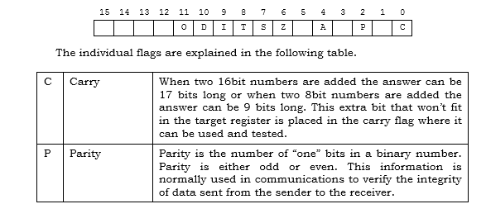

Slide 60
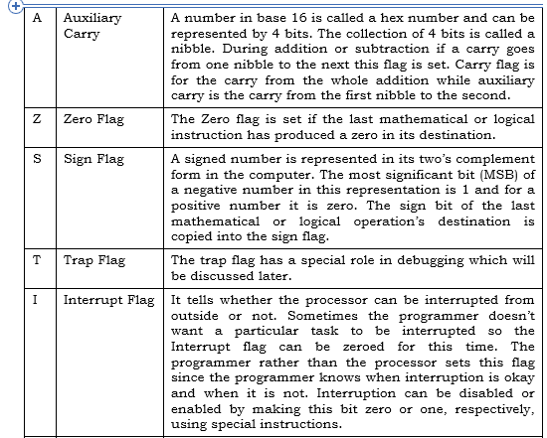

Slide 61
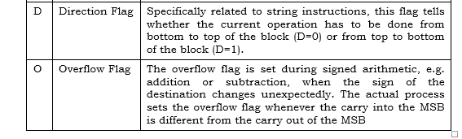

Slide 62
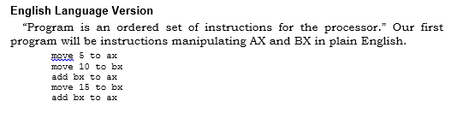

Slide 63
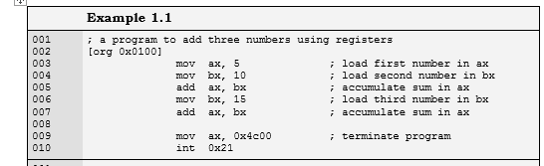

Slide 64
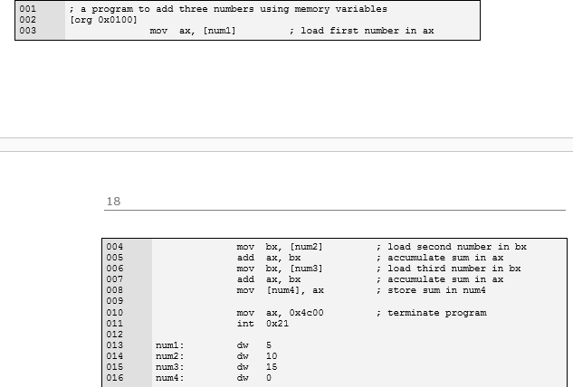

Slide 65
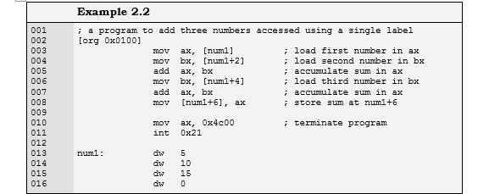
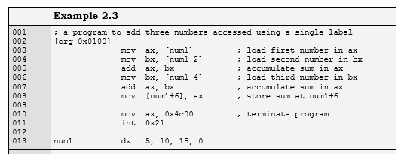

Slide 66
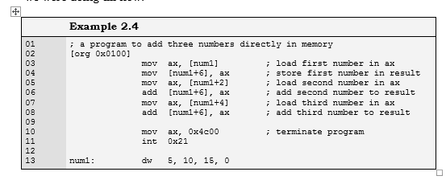
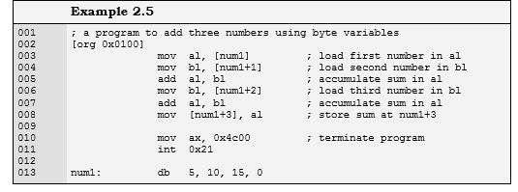

Slide 67
